Slide 1
Approximate Sampling & Counting
By: Tianxing He
Yuke Liao
Zhiming Zhou
F1003028
2012/12/11

Slide 2

Approximating the Permanent
Permanent:
Equivalence:
It’s equivalent to approximating the perfect matching

Slide 3




Some Notations
Denote partite graph
Set of matchings of size k
State space:
Markov chain:

Slide 4
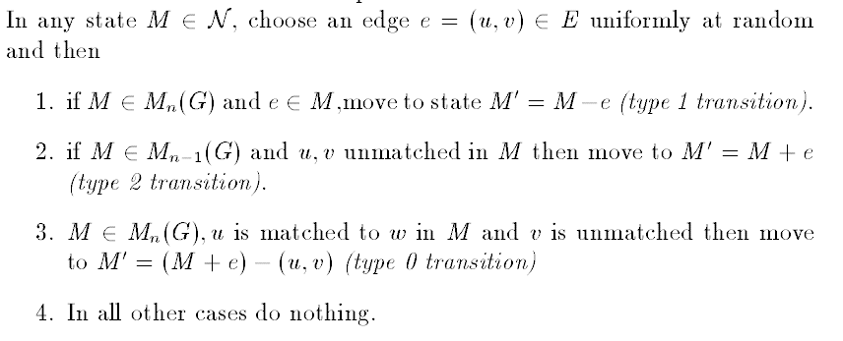
Transition in MC
Satisfies the 4 requirements

Slide 5
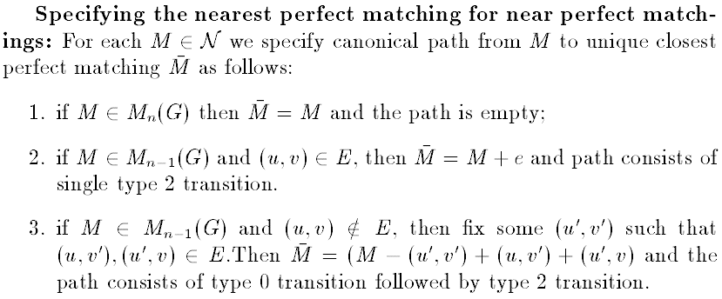
Uniform Generation of Perfect Matching

Slide 6
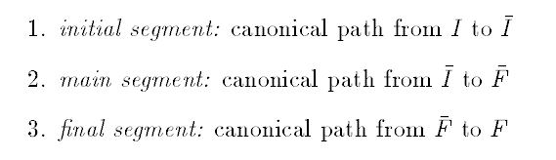
Canonical Path
All canonical path consists of 3 segments:

Slide 7
Bottleneck Parameter b
We have b = 3n⁴
Corr: there exists a fully polynomial almost uniform generator for perfect matching in dense graph

Slide 8
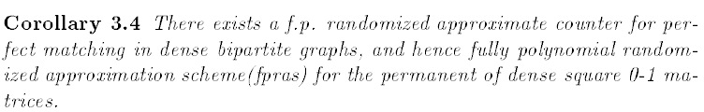
Approximately Counting Perfect Matching

Slide 9
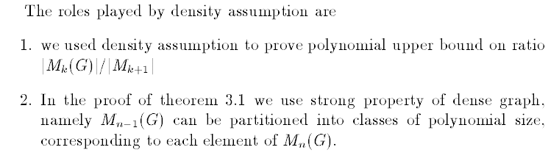
Role of Density Assumption

Slide 10
Thanks For Ur Listening!!!

